Slide 1

Bank Loan
Analysis
Group 3:
Pankaj Thakur
Sahil Mardhekar
Priyanka Madole

Slide 2

Introduction
Project focused on analyzing banking and loan data
Tools Used: Excel, SQL, Power BI, Tableau
Goal: Build dashboards and KPIs for stakeholders

Slide 3
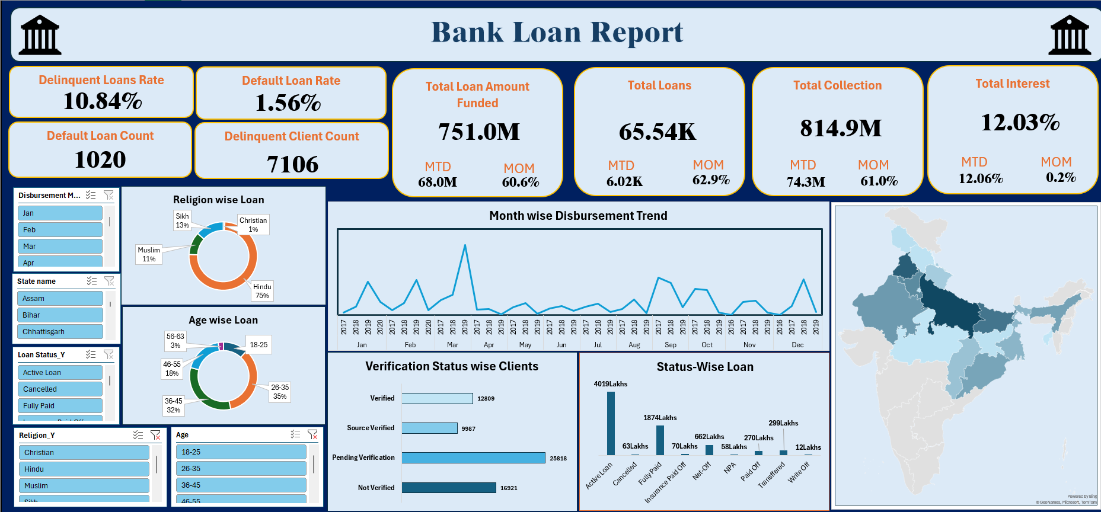
Excel

Slide 4
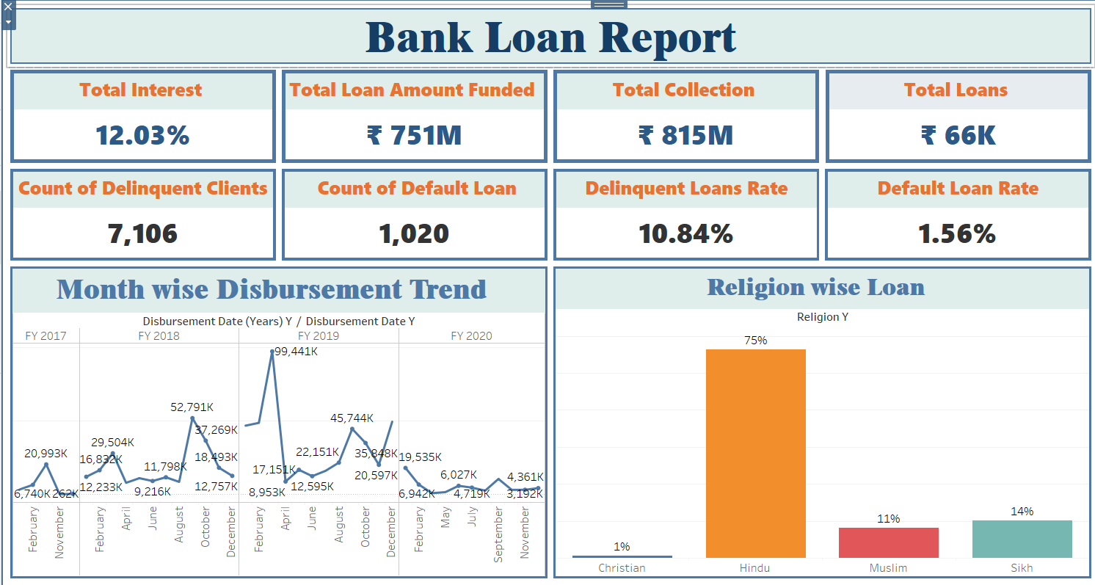
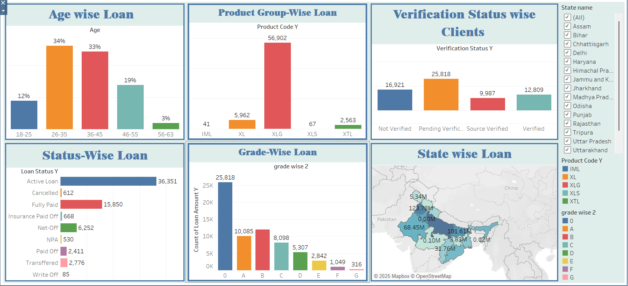
Tableau

Slide 5
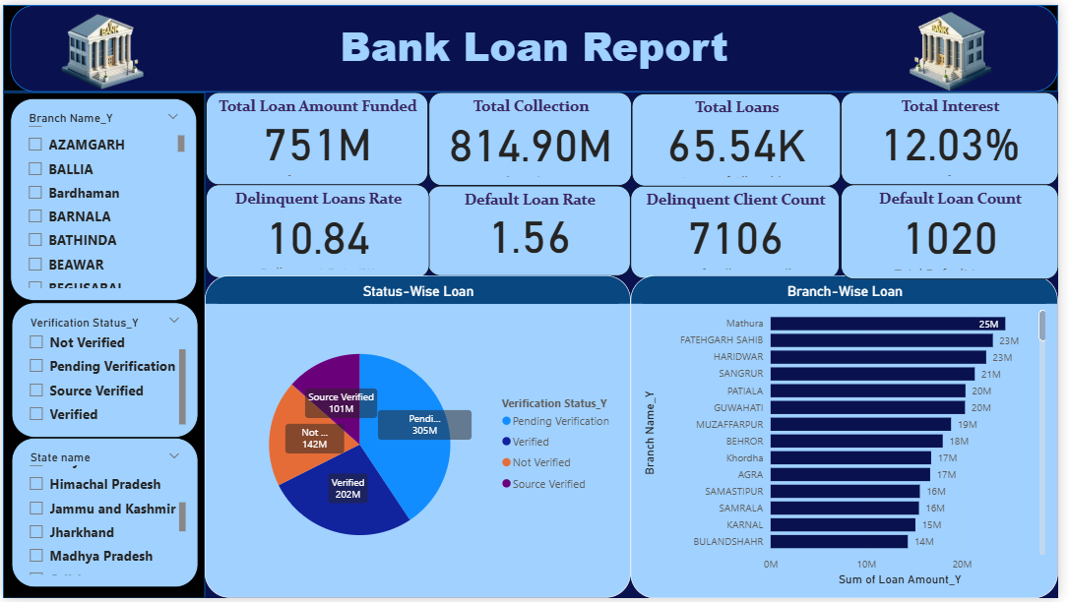
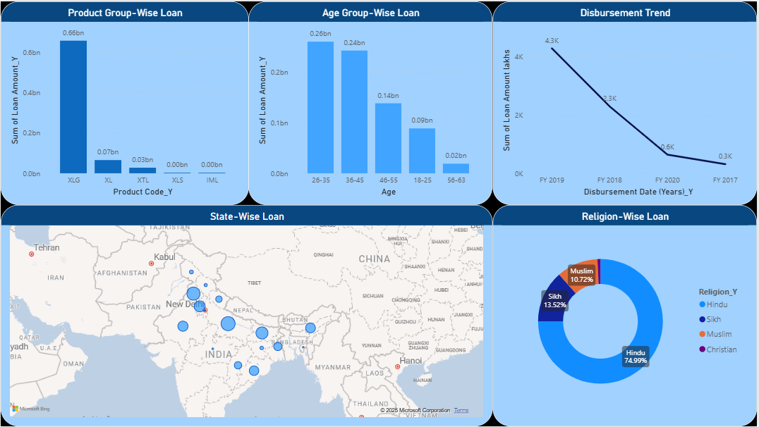

Slide 6
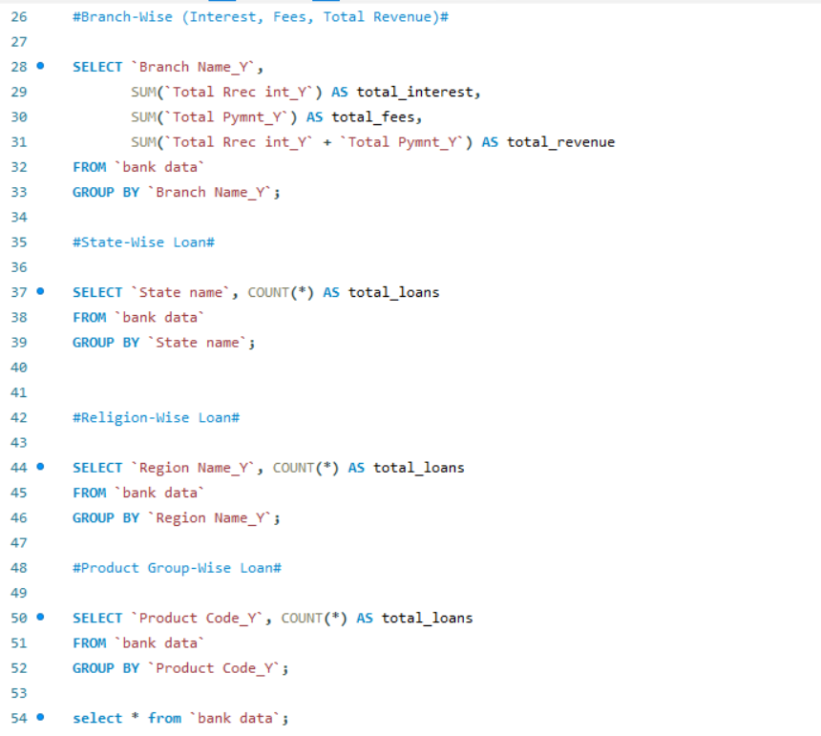

Slide 7
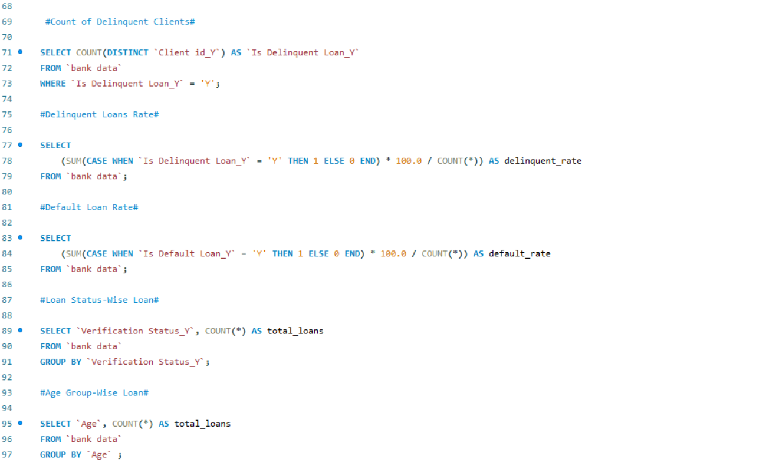
7

Slide 8

Challenges Faced
Data inconsistencies caused errors in Power BI visualizations.
Performance lags due to heavy queries and visuals.
Version Conflicts: Issues arised when multiple users used to edit without proper version control.
Facing challenges to load the data in data module.
Choosing the Wrong Chart Type.
Overloading the dashboard with too many visuals.
Group members were not responding in a timely manner.
There were a total of 6 members. 3 members left in the middle of the project, which caused increased workload for the remaining team.
Data import in SQL.

Slide 9

Thank you

